Slide 1
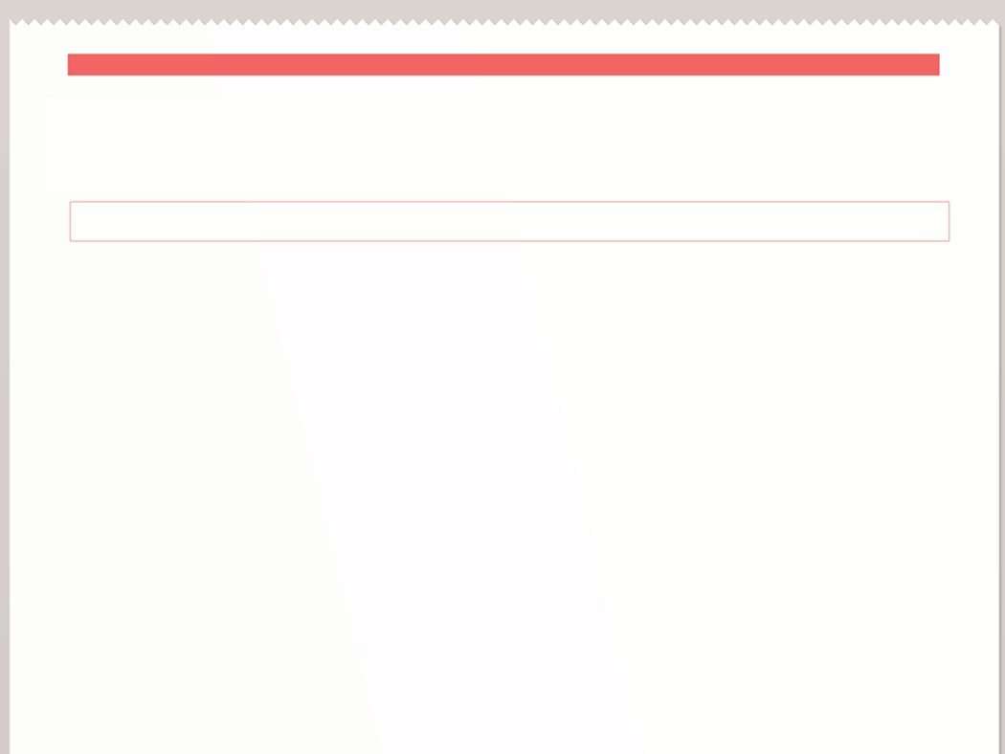
Valley High student starts fight over harassing tweets
Beware of Social Media!
Posting Negative Comments will Get You Fired
Social Media Lawsuits are Multiplying
Breaking News!
In libris graecis appetere mea. At vim odio lorem omnes, pri id iuvaret partiendo. Vivendo menandri et sed. Lorem volumus blandit cu has.Sit cu alia porro fuisset.
Ea pro natum invidunt repudiandae, his et facilisis vituperatoribus. Mei eu ubique altera senserit, consul eripuit accusata has ne.
In libris graecis appetere mea. At vim odio lorem omnes, pri id iuvaret partiendo. Vivendo menandri et sed. Lorem volumus blandit cu has.Sit cu alia porro fuisset.
Ea pro natum invidunt repudiandae, his et facilisis vituperatoribus. Mei eu ubique altera senserit, consul eripuit accusata has ne. Ignota verterem te nam, eu cibo causae menandri vim.

Slide 2
Mission and Goals

Slide 3
Definition of Social Media

Slide 4
Acceptable Use
Be authentic.
Be respectful of others.
Bring value.
Use good judgment. Think about consequences.
Abide by each social media platform’s terms of use.
Respect copyright: give credit where credit is due.
Don’t share secrets.
Respect your audience: avoid fights online.
Have “old world” contact information available.

Slide 5
DISCLAIMER!
The opinions expressed here are my own and do not necessarily reflect those of {Library Name}

Slide 6
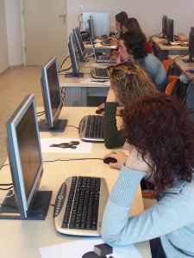
Training and Access

Slide 7
Contact Us

Slide 8
Believe in your patrons/students/Staff!
“A good policy starts from a position of trust--belief that your people want to do the right thing.”
--Social Media, Risk, and Policies for Associations

