Slide 1
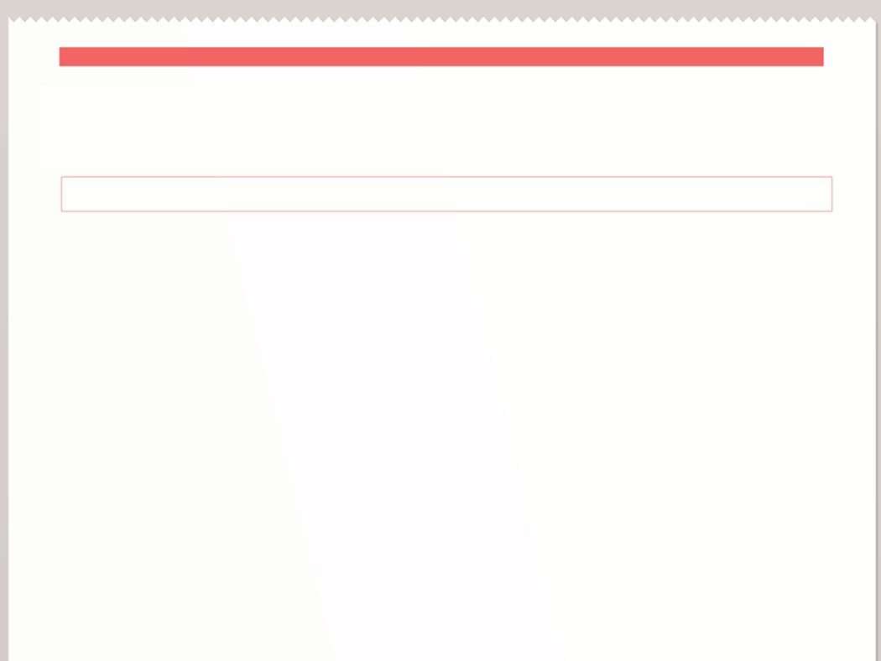
Valley High student starts fight over harassing tweets
Beware of Social Media!
Posting Negative Comments will Get You Fired
Social Media Lawsuits are Multiplying
Breaking News!
In libris graecis appetere mea. At vim odio lorem omnes, pri id iuvaret partiendo. Vivendo menandri et sed. Lorem volumus blandit cu has.Sit cu alia porro fuisset.
Ea pro natum invidunt repudiandae, his et facilisis vituperatoribus. Mei eu ubique altera senserit, consul eripuit accusata has ne.
In libris graecis appetere mea. At vim odio lorem omnes, pri id iuvaret partiendo. Vivendo menandri et sed. Lorem volumus blandit cu has.Sit cu alia porro fuisset.
Ea pro natum invidunt repudiandae, his et facilisis vituperatoribus. Mei eu ubique altera senserit, consul eripuit accusata has ne. Ignota verterem te nam, eu cibo causae menandri vim.

Slide 3
How to Behave in a “Social” Situation
Be authentic.
Be respectful of others.
Bring value.
Use good judgment. Think about consequences.
Abide by each social media platform’s terms of use.
Respect copyright: give credit where credit is due.
Don’t share secrets.
Respect your audience: avoid fights online.
Have “old world” contact information available.

Slide 4
DISCLAIMER!
The opinions expressed here are my own and do not necessarily reflect those of {Library Name}

Slide 5
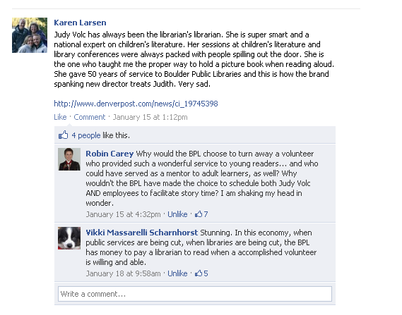
You aren’t going to love every comment…..

Slide 6
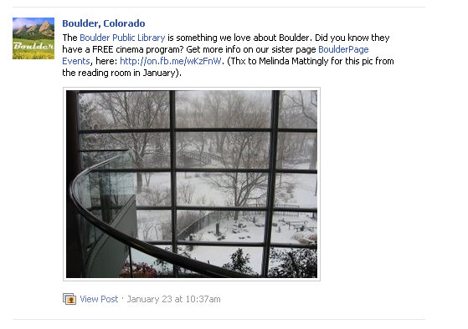
….but you will love most of them!

Slide 7
Believe in your patrons/students/Staff!
“A good policy starts from a position of trust--belief that your people want to do the right thing.”
--Social Media, Risk, and Policies for Associations

Slide 8
Contact Us!
Christine Kreger
Technology and Digital Initiatives Consultant
Colorado State Library
303-866-6946
http://colibraries.org
Terzah Becker
Digital Reference Librarian
Boulder Public Library
303-441-1990
http://boulderlibrary.org

